Slide 1

Music Classification
Max Wienandts
CSCI E-82 Advanced Machine Learning, Data Mining, and Artificial Intelligence
Fall 2023
Harvard Extension School

Slide 2
Introduction
Use cases:
Classify folders
Classify new songs in streaming services
Use as input for recommender systems
Use the model with transfer learning to other models related to audio in general

Slide 3
The Data
GTZAN Dataset (https://opihi.cs.uvic.ca/sound/genres.tar.gz)
https://www.kaggle.com/datasets/andradaolteanu/gtzan-dataset-music-genre-classification
Not a competition, just the dataset.
Problem: Classify music in 10 genres: blues, classical, country, disco, hiphop, jazz, metal, pop, reggae, rock.
Observations: 100 for each music genre;
Variables: 30 seconds of music in WAV format.
In Kaggle, there is also the Mel Spectrograms, and a table with some features. These will not be used.

Slide 4
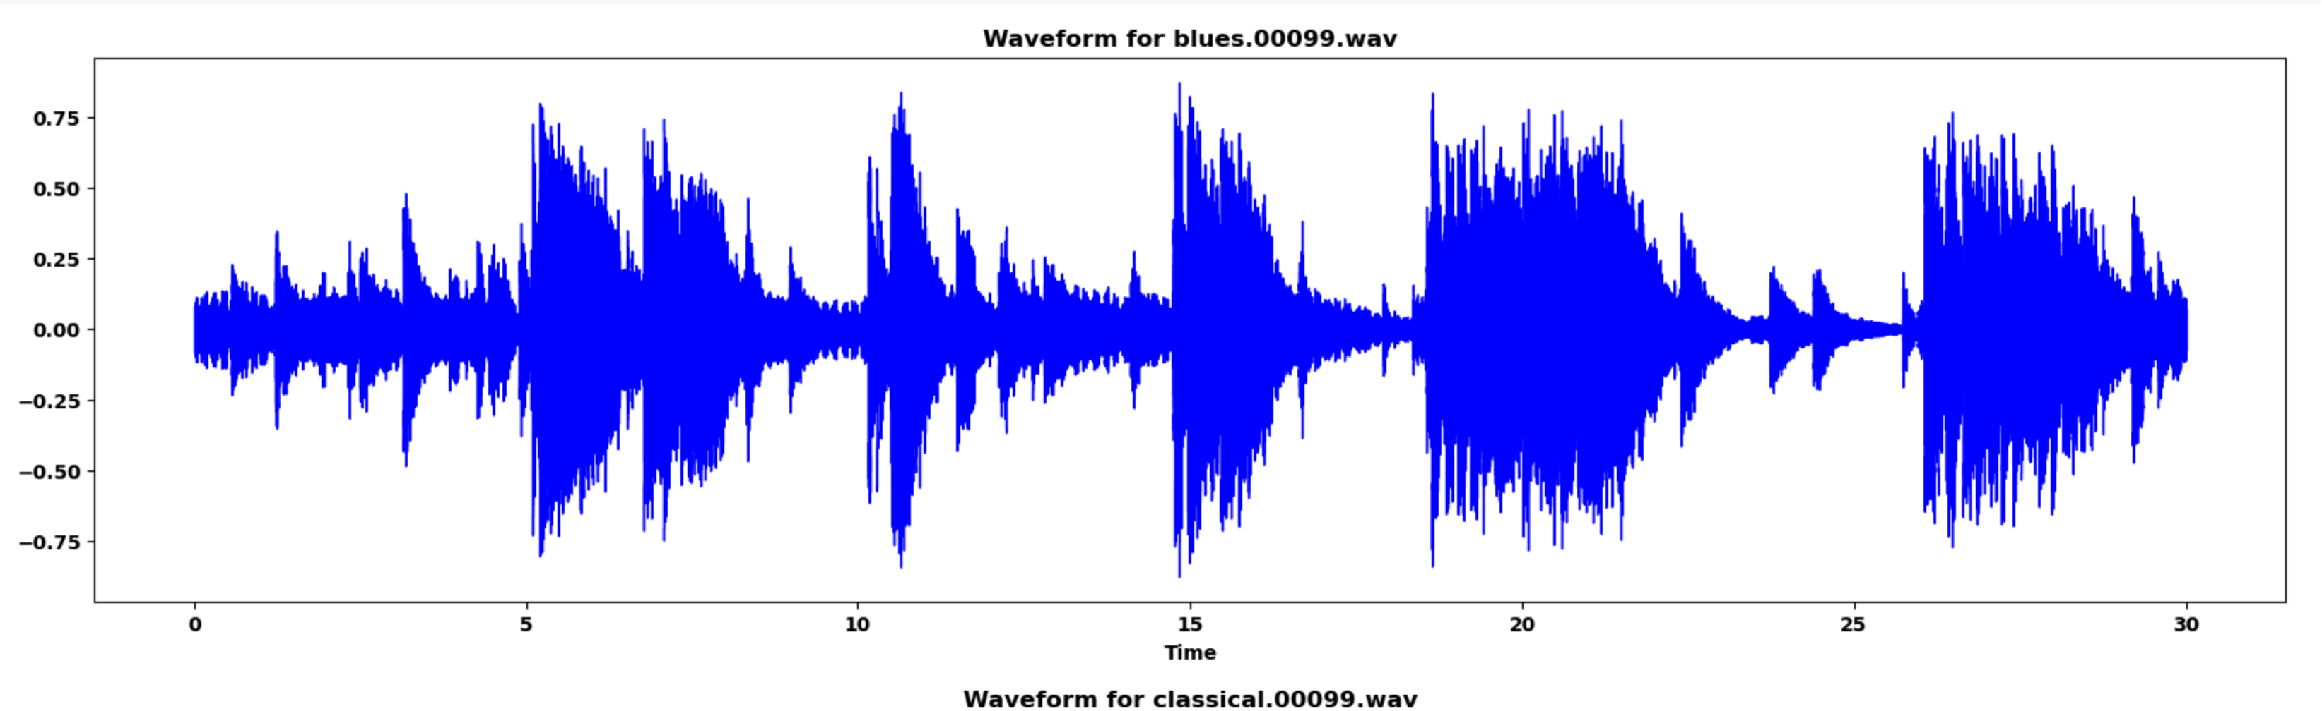
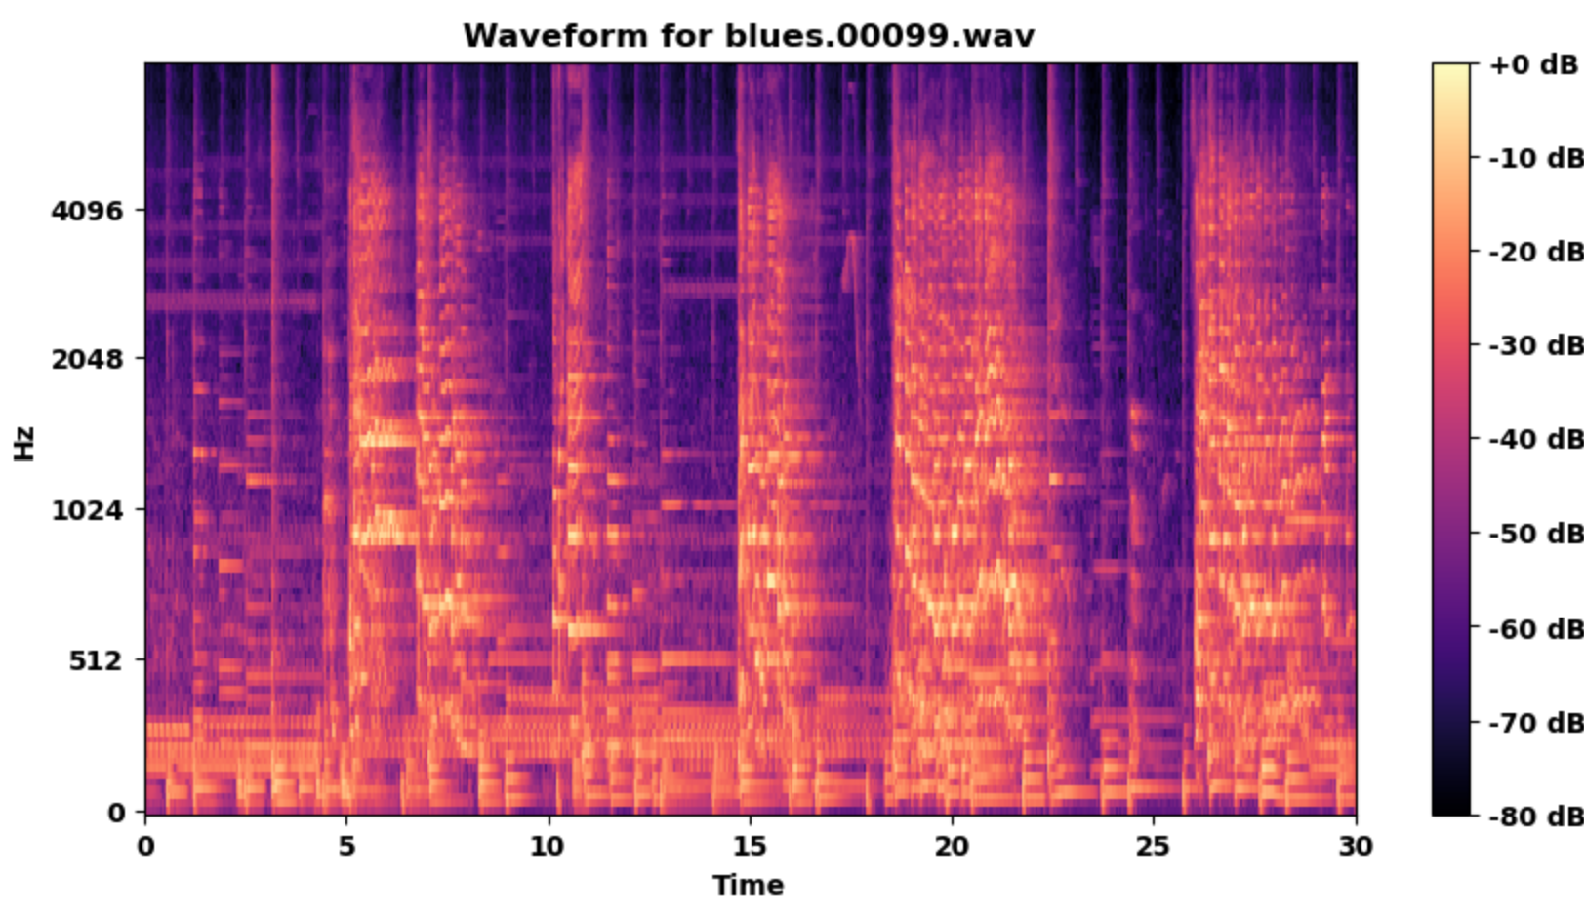
Waveform signal Vs. MEL Spectrograms
Waveform signal:
MEL Spectrogram:
The spectrogram is the short-time Fourier transform applied in the waveform signal.
The spectrogram is a way to visually represent a signal’s loudness, or amplitude, as it varies over time at different frequencies.
The MEL transformation is a unit of pitch such that equal distances in pitch sounds equally distant to the listener.
https://medium.com/analytics-vidhya/understanding-the-mel-spectrogram-fca2afa2ce53

Slide 5
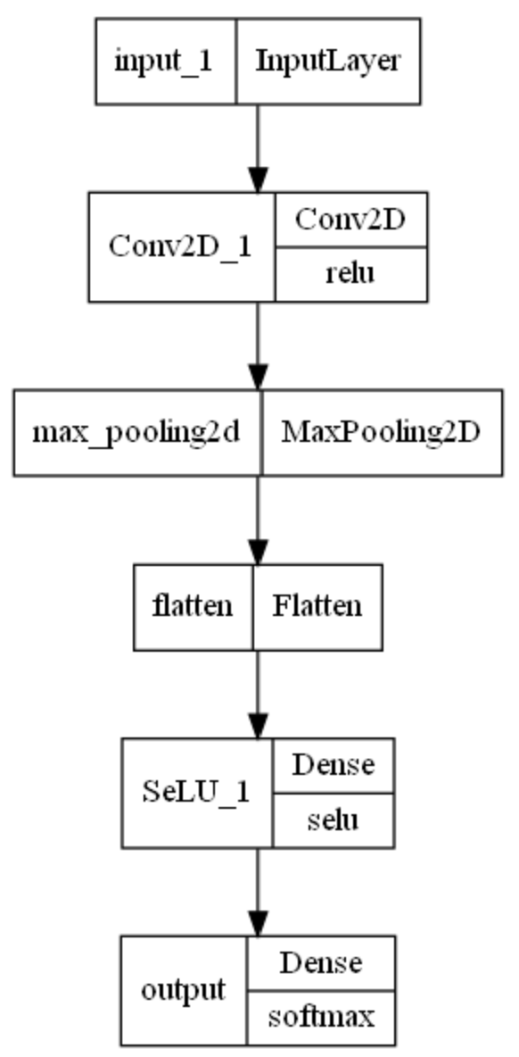
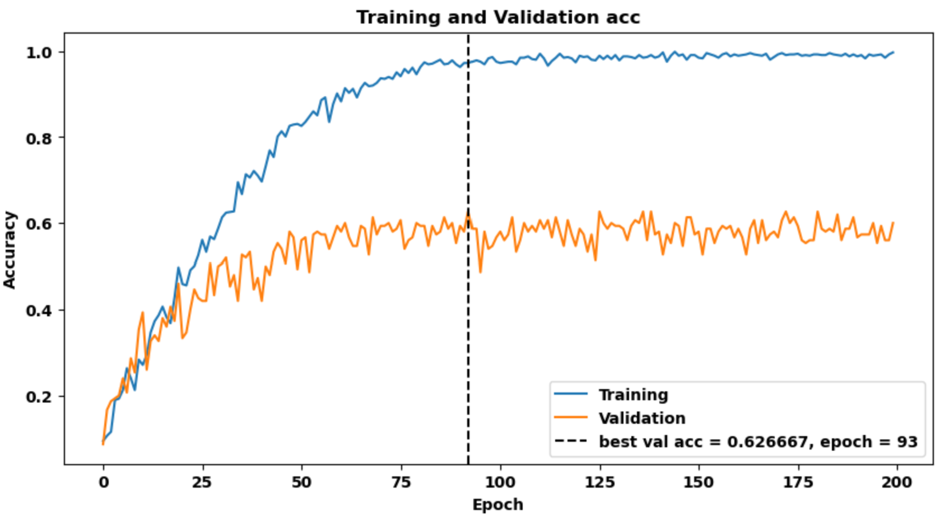
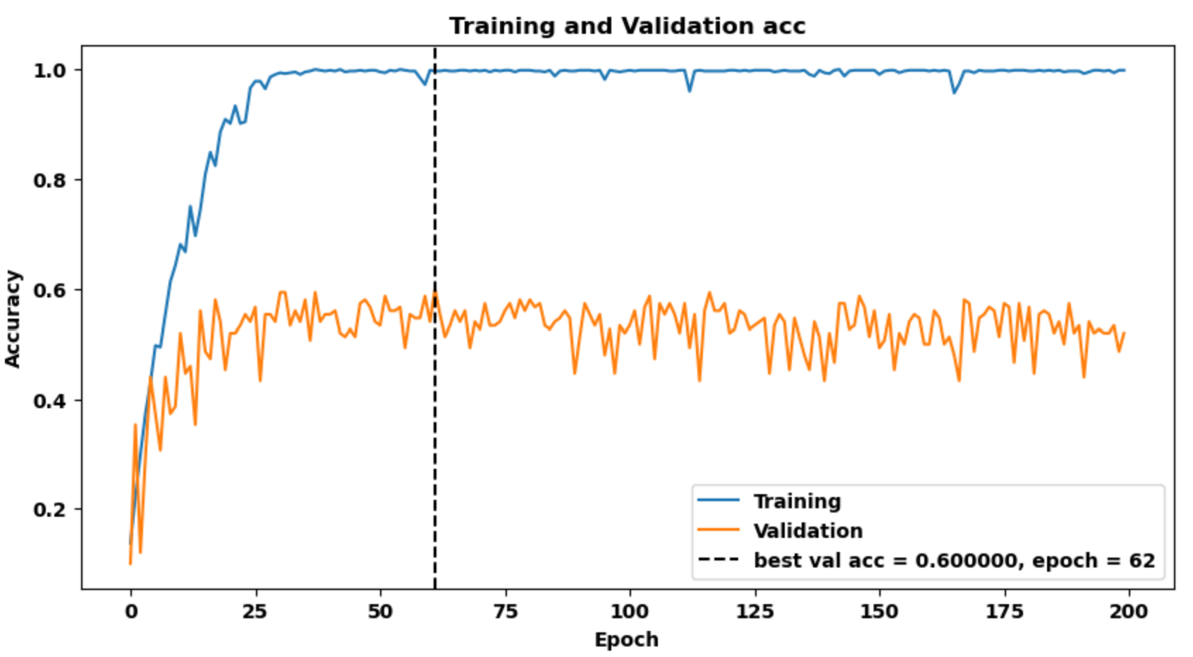
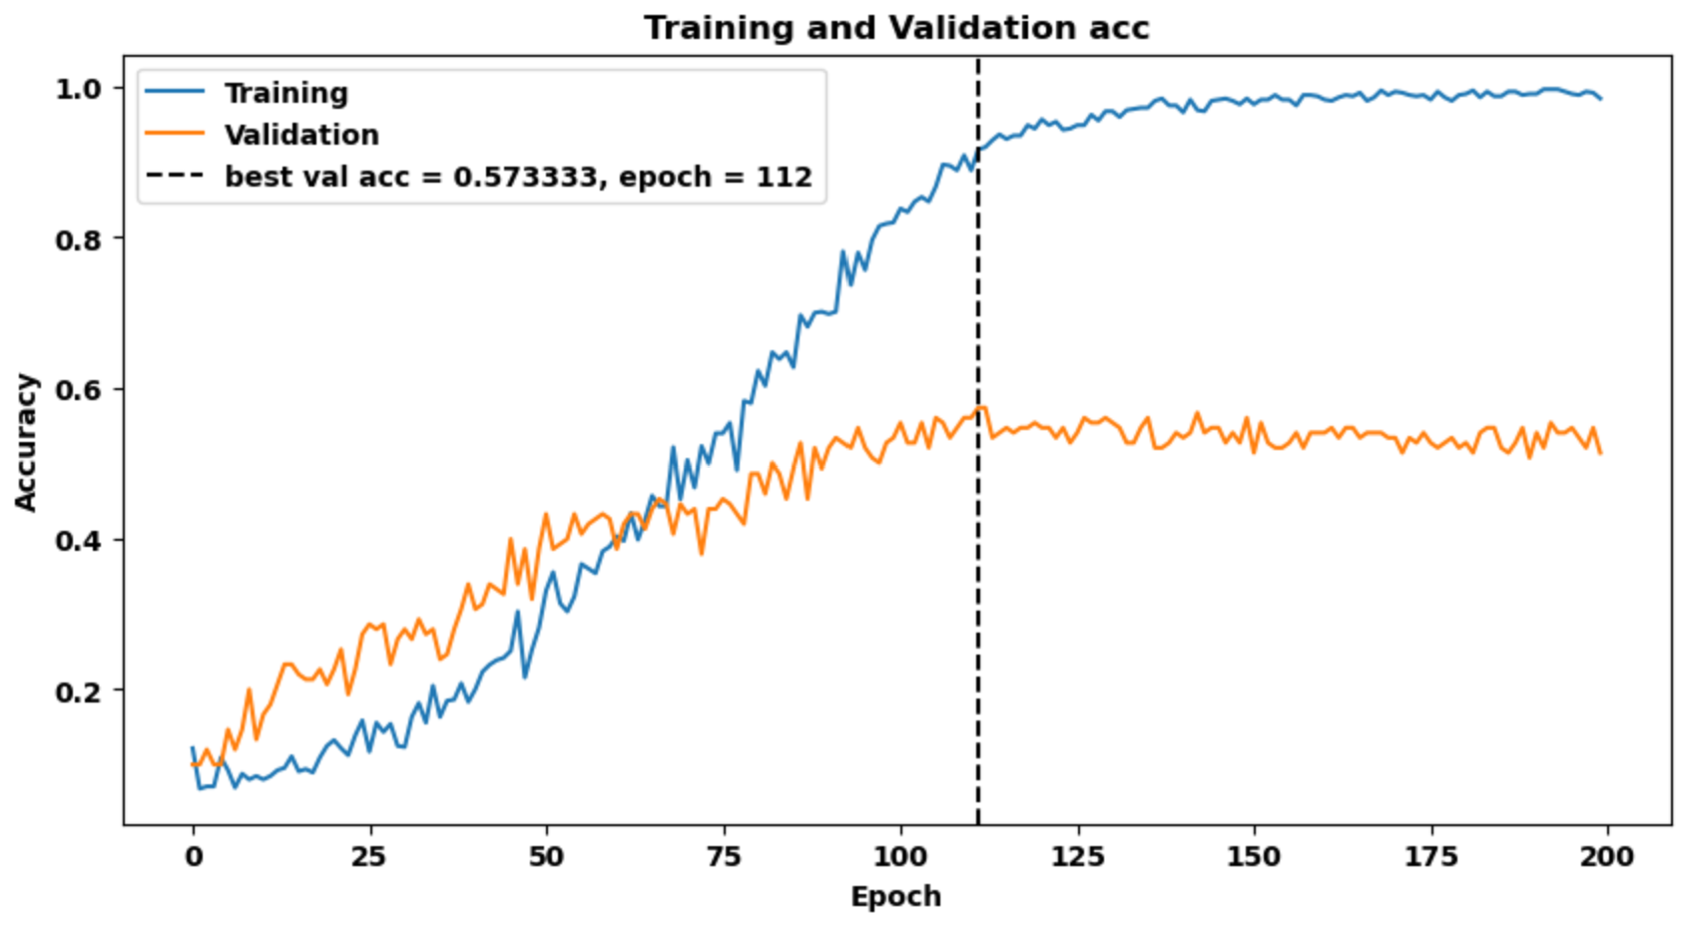
Models
Baseline model:
Trying to remove overfit:
Dropout layers;
Kernel regularization
Bias regularization
New information:
Waveform signal

Slide 6
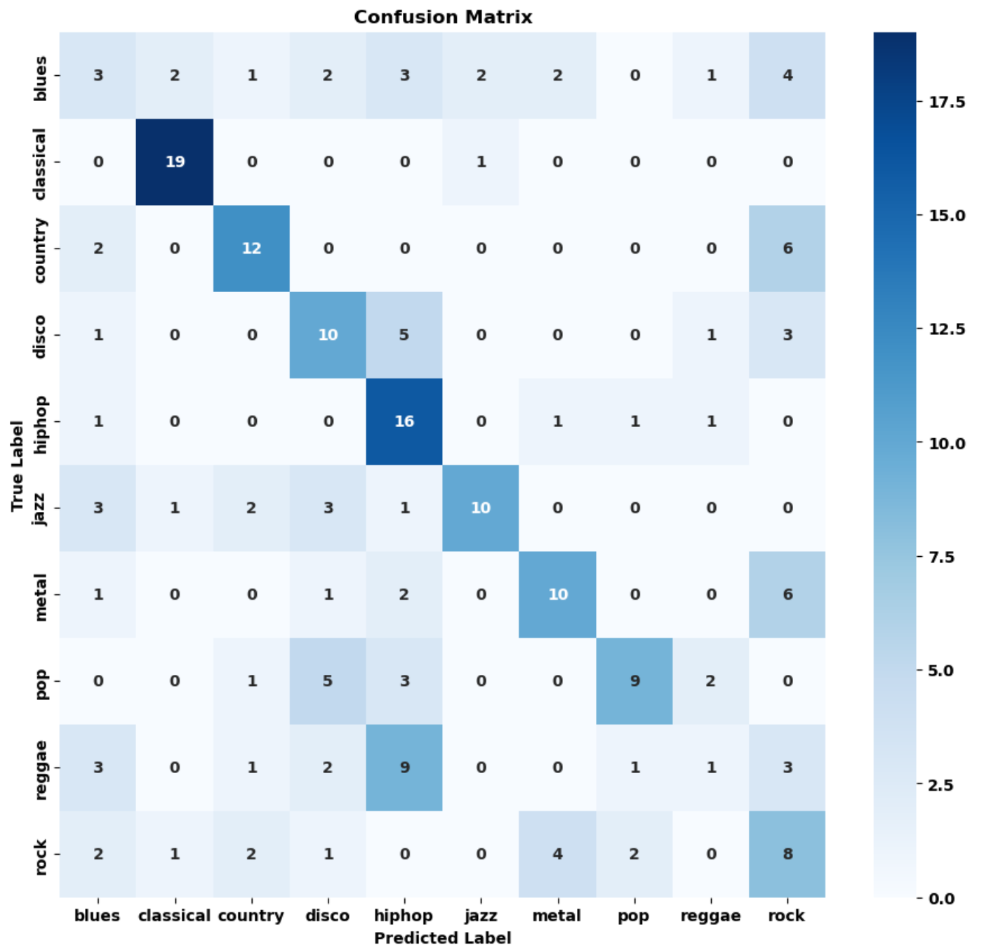
Results

Slide 7
Next step
Transfer learning:
“Automatic Music Genre Classification using Deep Learning”. S. Rakesh1, M. Venu Gopalachari1, and G. Kiran Kumar. https://doi.org/10.1063/5.0161104
EfficientNetB2, Validation accuracy: 0.8141
Solves the problem of few observations

